Slide 1

Tutoring is bad
Gus Lipkin

Slide 2
Problem and Anecdote

Slide 3
Problem
The tutoring system at Florida Poly is bad
Tutors make their own schedules
There is not a tutor for every class
Tutoring sessions can become crowded

Slide 4
Root cause
Each department pays their own tutors
Each department is trying to maximize class coverage in their own department
Each department is trying to maximize the number of students that can attend tutoring
No department wants to pay for tutors for another department
This is

Slide 5
Anecdote

Slide 6


This is Gus taking stats 1

Slide 7


This is Gus one week before his midterm

Slide 8


This is Gus At tutoring Before the exam
Two Days
Eighteen hours
Six Days
Five Days
One week
Four Days
Three Days

Slide 9


This is Gus Asking Dr Bunn where the stats tutor has been

Slide 10

This is Gus taking a crash course in stats 1 from dr bunn

Slide 11


This is Gus Barely passing his exam

Slide 12
The state of tutoring today

Slide 13
Description
Some courses offer pre-scheduled group tutoring with tutors

Slide 14
The current tutoring model
Departments choose classes for tutoring
Departments hire tutors for those classes
Tutors set their availability
Departments schedule tutoring
Tutors are available for a specific class at a set time
Students choose to come in for tutoring

Slide 15
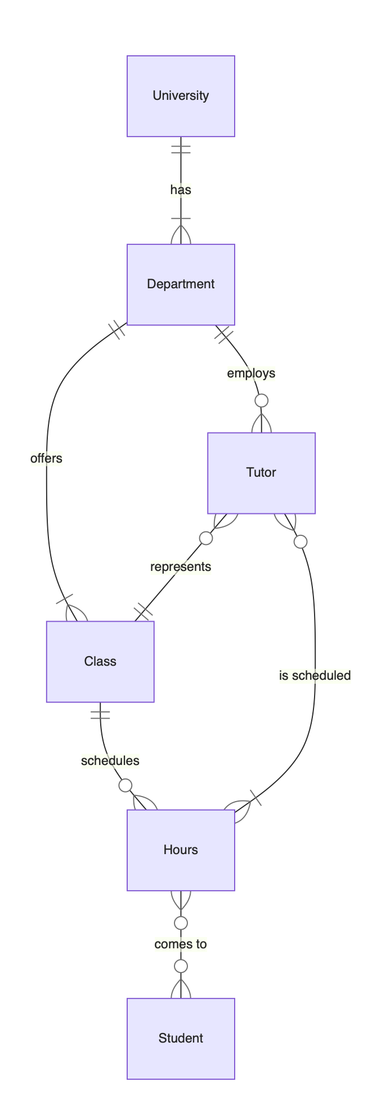
As an entity relationship diagram

Slide 16
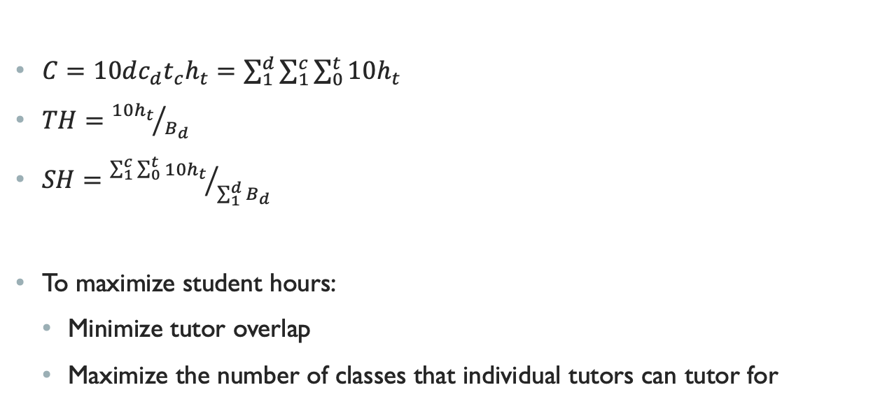
Icky Math
$C=10dc_{d}t_{c}h_{t}=\sum_{1}^{d}{\sum_{1}^{c}{\sum_{0}^{t}{10h_{t}}}}$
$TH={10h_{t}}/{B_{d}}$
$SH={\sum_{1}^{c}{\sum_{0}^{t}{10h_{t}}}}/{\sum_{1}^{d}{B_{d}}}$
To maximize student hours:
Minimize tutor overlap
Maximize the number of classes that individual tutors can tutor for

Slide 17
Possible alternatives

Slide 18
A One-on-one tutoring model

Slide 19
Description
Tutors are knowledgeable in a variety of subjects
Students book time with a tutor for a specific class

Slide 20
A one-on-one tutoring model
University
University
Class
Tutor
Department
Class
Tutor
Tutor
Hours
Student

Slide 21
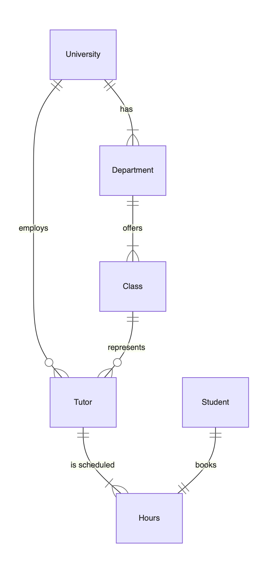
As an entity relationship diagram

Slide 22
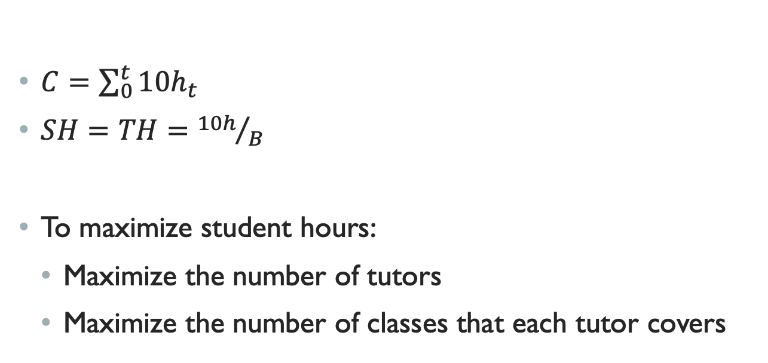
Icky Math
$C=\sum_{0}^{t}{10h_{t}}$
$SH=TH={10h}/B$
To maximize student hours:
Maximize the number of tutors
Maximize the number of classes that each tutor covers

Slide 23
A Hybrid tutoring model

Slide 24
Description
Combine a group tutoring and one-on-one tutoring model
For high demand courses, there are scheduled tutoring sessions
For high and low demand courses, students can schedule time with a tutor

Slide 25
A Hybrid tutoring model
I tried to make a flowchart but it’s just easier to show you the ERD

Slide 26
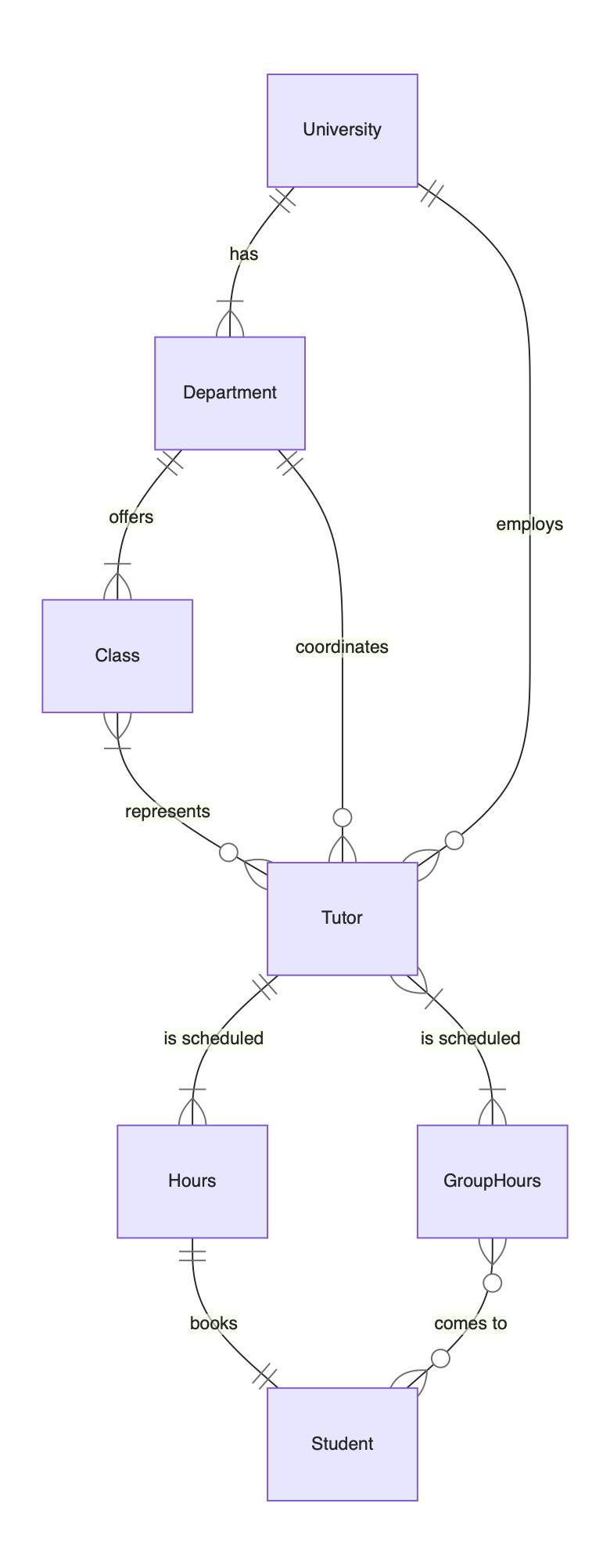
As an entity relationship diagram

Slide 27
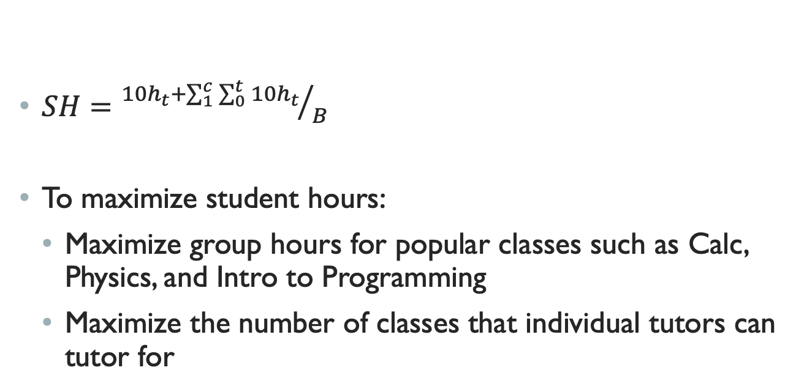
Icky Math
$SH={10h_{t}+\sum_{1}^{c}{\sum_{0}^{t}{10h_{t}}}}/B$
To maximize student hours:
Maximize group hours for popular classes such as Calc, Physics, and Intro to Programming
Maximize the number of classes that individual tutors can tutor for

Slide 28
Conclusions

Slide 29
This is a difficult problem to tackle
Without sufficient proof that working together will save money and help students, no departments will want to pool resources
I don’t know how to do enough of the theoretical math to convince anyone

Slide 30
A hybrid model is probably best
You get the best parts of group tutoring and one-on-one tutoring
It has potential to be at least as efficient as group tutoring

Slide 31
Tutoring is bad
Gus Lipkin

